Slide 1
PORTUGUESE MUTUAL GUARANTEE SCHEME
1994 – 2016
22 years
of activities
in favour of SME,
Employment,
Exports and
the
Economic Growth
of the
Portuguese Economy
Miguel Sousa Branca
SPGM Managing Director
Oporto, 23rd June 2016
Notes:
1

Slide 2
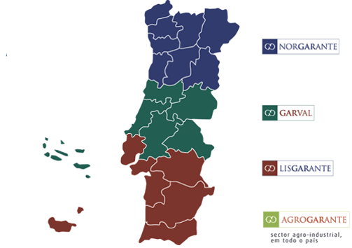
covers the whole national territory, being dedicated to the rural economy
FCGM
Fundo de Contragarantia Mútuo

Slide 3
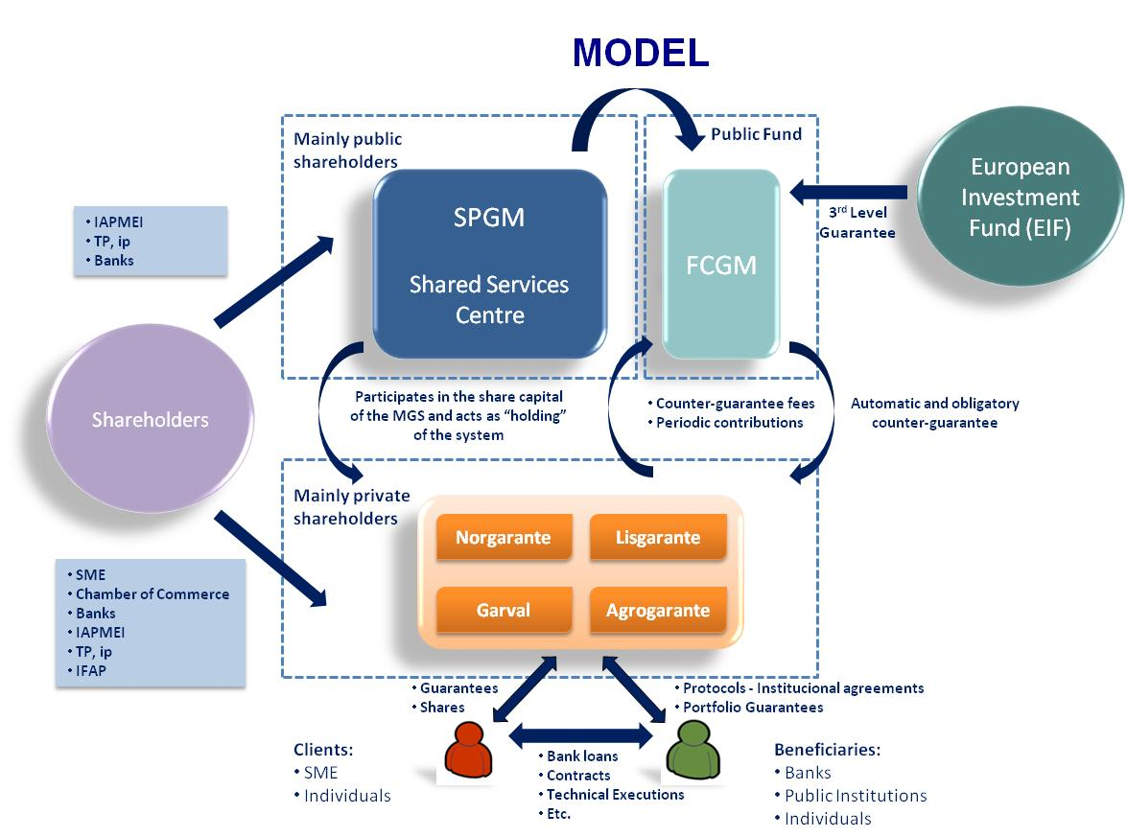
FCGM
Fundo de Contragarantia Mútuo

Slide 4
investment of sme
€ 23 000 million
guarantees
€ 11 000 million
counterguarantee
€ 8 500 million
public finance
€ 1 300 million
loans to sme
€ 22 500 million
FCGM
Fundo de Contragarantia Mútuo

Slide 5
the impact of the Portuguese Mutual Guarantee Scheme in:
conditions of finance got by sme, such as
cost of debt
and actual access to a bank loan
amount of investment made by sme
amount of exports from sme
amount of sales of sme / variation of GDP
employment
FCGM
Fundo de Contragarantia Mútuo

