Slide 1
Economic Impact of the
Portuguese Mutual Guarantee Scheme
2009-2014
Vasco Rodrigues
AECM Seminar
Porto, 23 June 2016

Slide 2
Mutual guarantees in Portugal
New guarantees 2009-2014

Slide 3
What we want to measure
At the firm level
At the macro level
Access to finance
Cost of debt
Investment
Exports
GDP – Gross domestic product
Employment

Slide 4
How we do it
Accounting data
  Downloaded from public sources for some 120 thousand firms
    44 thousand users of mutual guarantees
  Some variables can only be measured by approximation
Econometrics
  Estimate quantitative relations between each variable of interest (access to finance, cost of debt, investment, exports) and its determinants
Determinants
  Suggested by theory
  Use of mutual guarantees (MG)
    v1 – dummy variable (yes/no)
    v2 - dummy variable (yes/no) + interaction with Age, Size, and Fixed Assets / Total Assets

Slide 5
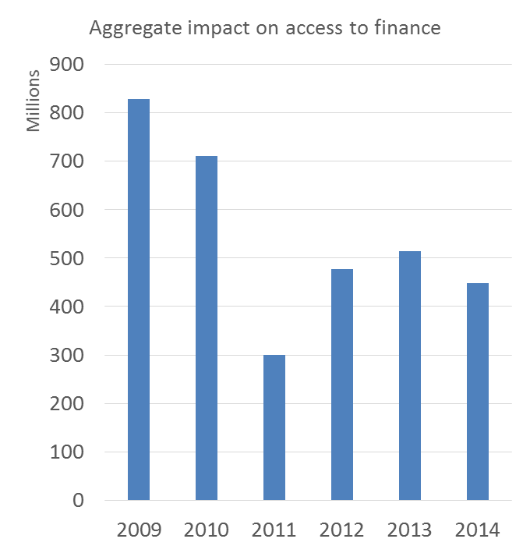
Access to finance
Results
To be explained: ratio Debt / Total Assets
Determinants: Cost of Debt, Growth (current, future), Profitability, MG, Year dummies, Firm dummies
Mutual guarantee impact per firm
  +5.1 percentage points
  Decreasing with Size, slightly increasing with Age
Aggregate impact 2009-2014
  3.3 billion euros additional debt

Slide 6
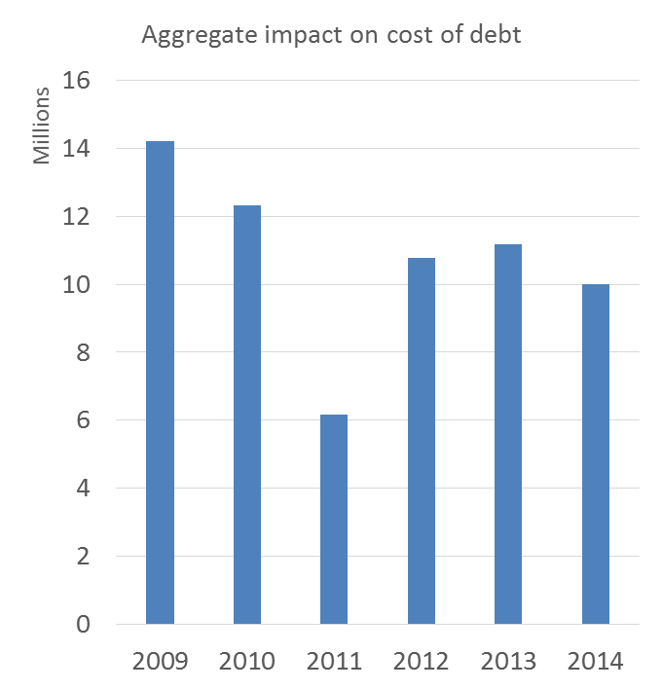
Cost of debt
Results
To be explained: ratio Interest / Average Debt
Determinants: Size, Liabilities / Total Assets, Profitability, Fixed Assets / Total Assets, MG, Year dummies, Firm dummies
Mutual guarantee impact per firm
  -0.47 percentage points
  Impact is stronger for small and young firms
Aggregate impact 2009-2014
  65 million euros reduction in interest paid

Slide 7
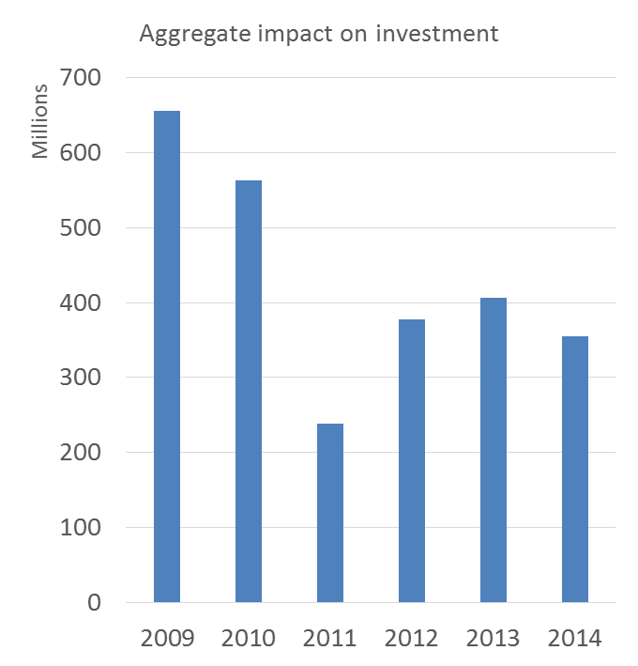
Investment
Results
To be explained: Variation in Total Assets / Total Assets
Determinants: Cost of Debt, Size, Fixed Assets / Total Assets, Growth (current, future), Profitability (past, current, future), MG, Year dummies, Firm dummies
Mutual guarantee impact per firm
  +4.2 percentage points
  Stronger for small firms
Aggregate impact 2009-2014
  2.6 billion euros additional investment

Slide 8
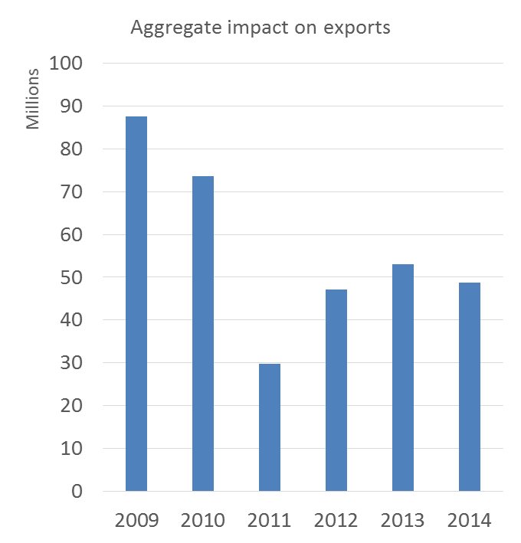
Exports
Results
To be explained: Exports / Total Sales
Determinants: Size, Age, Experience, MG, Year dummies, Industry dummies
Mutual guarantee impact per firm
    0.57 percentage points
Aggregate impact 2009-2014
    340 million euros additional exports

Slide 9
Portuguese Mutual Guarantee Scheme
2009-2014
Significant economic impact
  3.3 billion euros of additional debt
  65 million euros reduction in interest
  2.6 billion euros additional investment
  340 million euros additional exports
The impact is stronger on small firms

