Slide 1
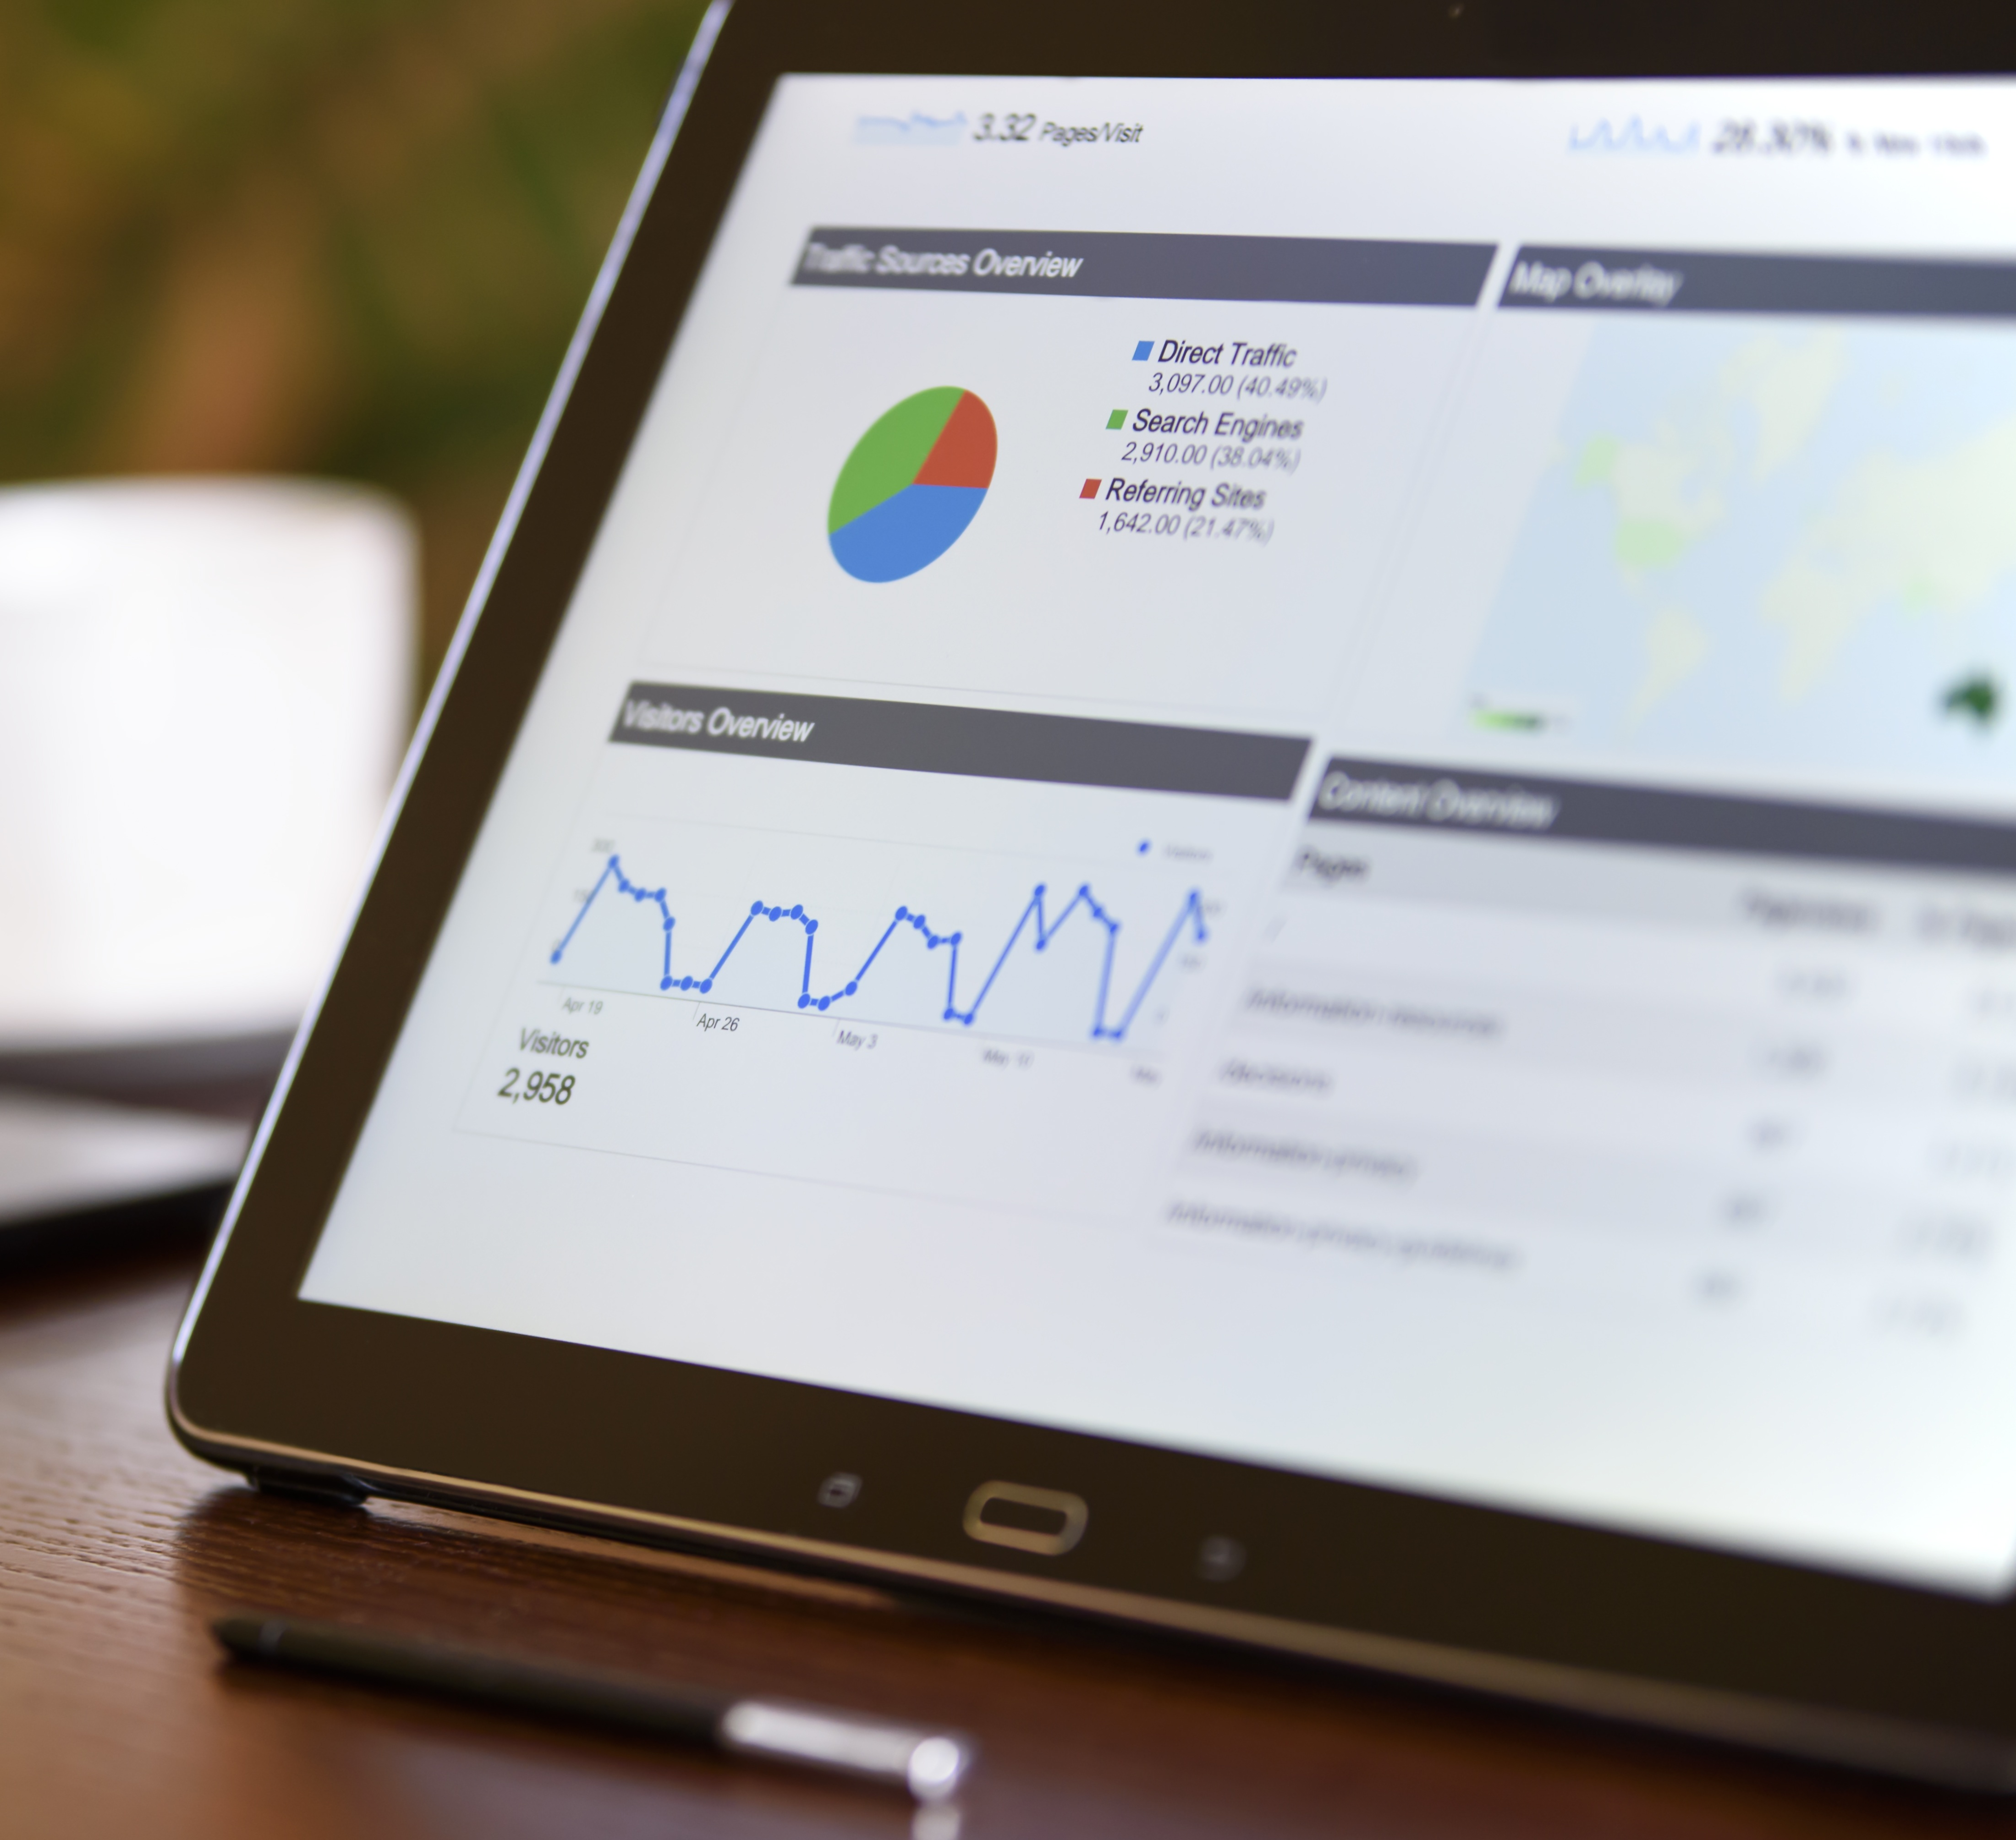
FINANCING
THE DIGITALIZATION OF SMEs
Zenón Vázquez
General Manager
ELKARGI 23rd September

Slide 2

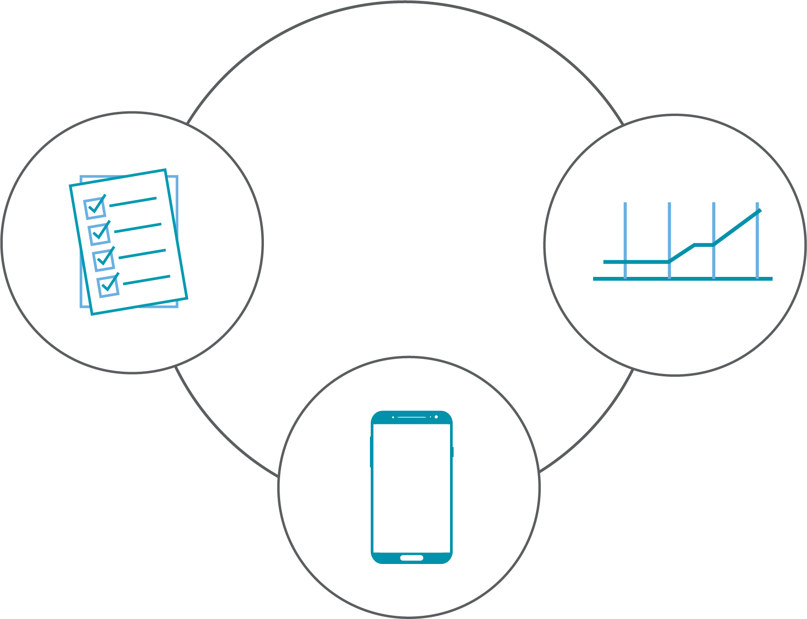
DIGITALIZATION IS A MUST
Efficiency
Process
improvement
New business models
Culture is the key

Slide 3

EXPERIENCE IN THE DIGITALIZATION OF INDUSTRIAL PROCESSES
Consolidated
Visionaries
DIGITAL intensity
Incipient
Conservatives
Intensity in the management of the transformation

Slide 4

ADVANCED MANUFACTURING EXPERIENCE
A new model of organization and control of the value chain or the product life cycle, through the manufacturing systems. This new model is possible, through information technologies.
Smart factory
Industrial internet
Connectivity and datification
Manufacturing processes are in a digital transformation. An industrial revolution produced by the advancement of information technologies: computing and software.

Slide 5
OBJECTIVES
PROBLEMS
Knowledge improvement and identification of inefficiencies
1 Sensorization and traceability
2. Communications and protocols
3. Interoperability
4. Infrastructures
5. Data integration
6. Cleanliness and quality
7. Data applicability
Zero defect manufacturing
Energy consumption efficiency
Real time monitoring
Behavior prediction
Predictive Maintenance
Zero stock
Advanced logistics
Intelligent process automation
Production machine performance/action
Efficiency and profitability

Slide 6

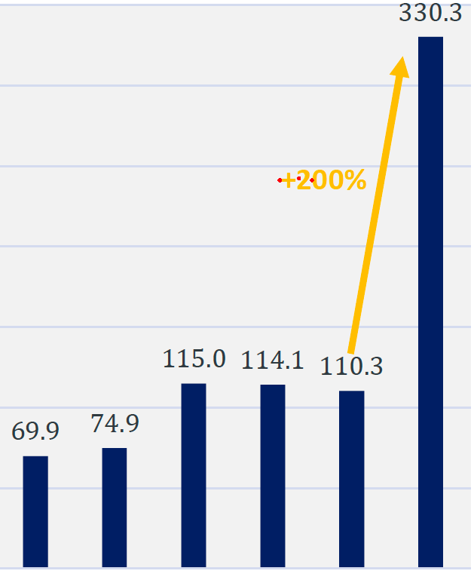
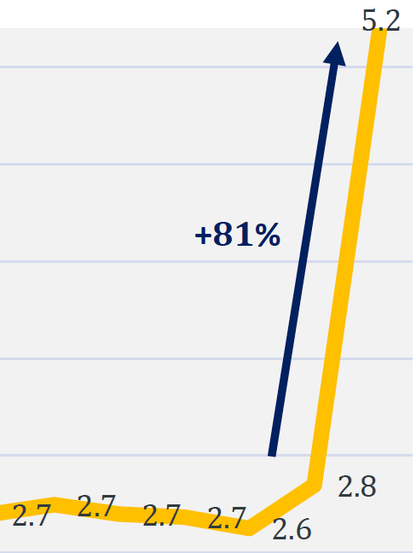
FINANCING
(2020)
Evolution of the
outstanding gurantee
volumen (in billon EUR)
Evolution of the number
of supported SMEs
(in millon units)
2015
2016
2017
2018
2019
2020
2015
2016
2017
2018
2019
2020
The example
of Austria
2020
2019
4.769
financed projects
81.250
financed
projects
X 17

Slide 7






FINANCING
Pioneer in Europe
investors
Bounds
New source of financing
Diversification: Non-bank
Financial product of Guarantee
Institutions
Fixed interest rate
Alternative fixed
Income market
SME
Public bank
Underwriting of bounds
European invest
found
product
Spanish guarantee Institutions

Slide 8


CONCLUSIONS
Next Generation EU funds will support digitalization and sustainability
Business needs
to be sustainable
and profitable
We need to
reinvent ourselves
Technology
is a must
We do need think
about our business
models

Slide 9
THANK YOU!
Zenón Vázquez
General Manager
ELKARGI 23rd September

