Slide 1
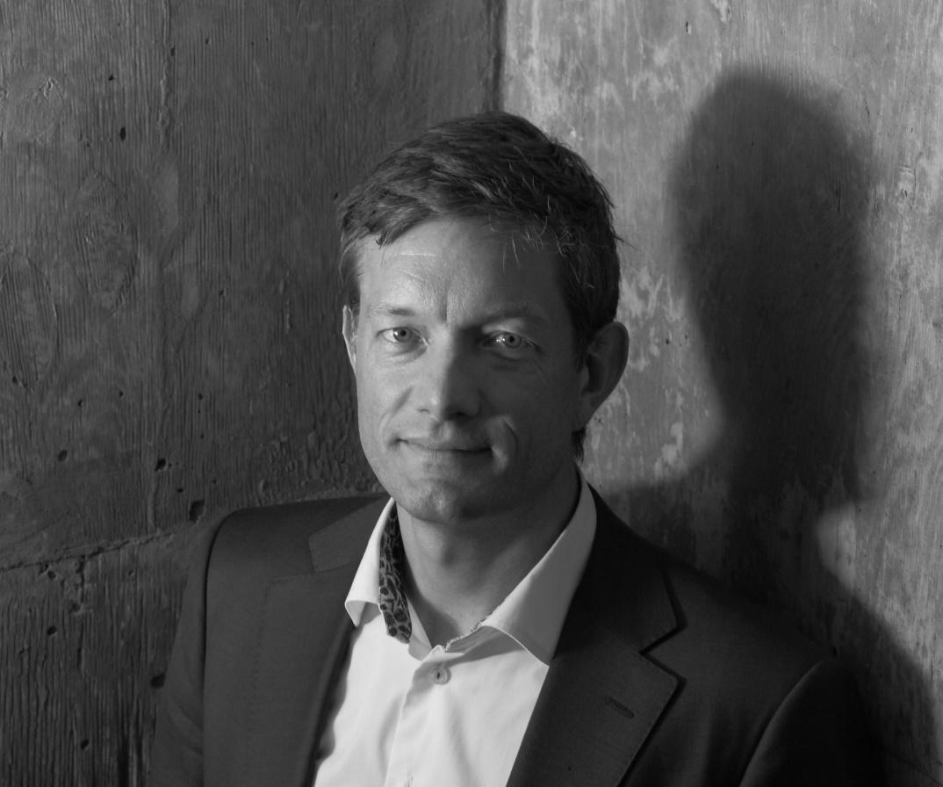
Dennis is Managing Partner at ReputationInc leading large international client projects and the Nordic operation from Oslo. He has over two decades global experience consulting across diverse business sectors and governmental and non-governmental segments.
With an MSc in economics and MBA in Corporate Communications (with honours), Dennis' approach to client solutions is strongly rooted in analytics. He has been involved in academic and client based research on reputation, sustainability and financial communications.
Dennis has a proven track record in helping clients enhance performance through powerful diagnostics, deep expertise and a creative solution oriented mind.
Dennis is a regular lecturer at business schools and partner at NORA (Nordic Alliance of Communication and Management). He is also board member of the European Association of Communication Directors (EACD).
When not immersed in client work, he can be found skiing or marathon training on remote Norwegian mountains with his family.

