Slide 2
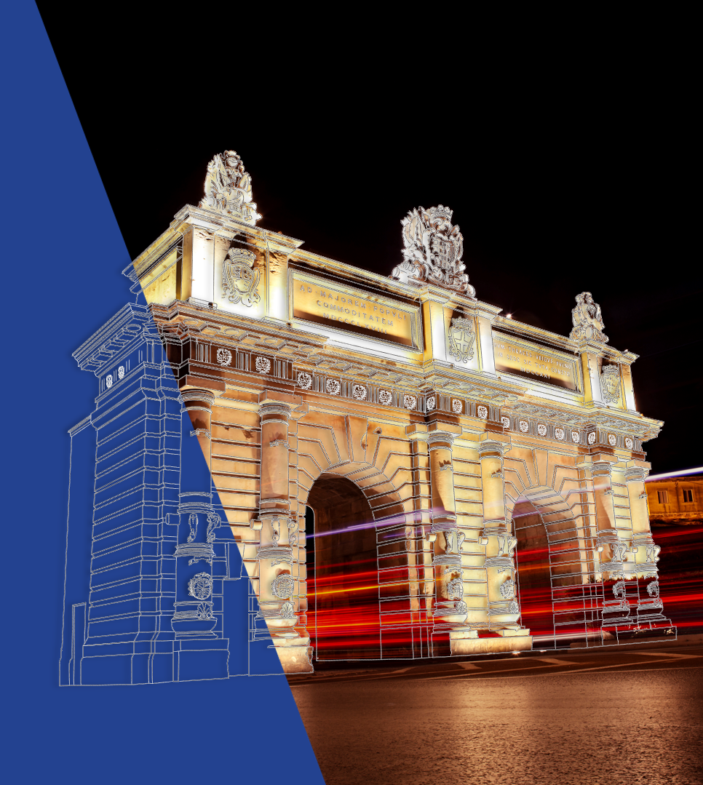
Malta Development Bank
Operational Training Sessions (OTS) on Financing Digital Innovation
February 2025

Slide 3
MDB Product Portfolio
SMEs
MDB Facilities
Infrastructure
Financial instruments funded from ESIF (FSMA) and FSMA+
Co-financing +
partial guarantee
COVID-19 Response
Ukraine Response
Tailored facility
GCLS
Portfolio Guarantee Schemes
SME Invest
SGS
SGS-S
SGS-CC
GCLS-S
Managed schemes (MDB as implementing body)
Managed schemes (MDB as implementing body)
Schemes involving direct co/lending
Schemes involving direct co/lending
Guaranteed schemes intermediated by commercial banks
Guaranteed schemes intermediated by commercial banks
Sub-schemes – covers SMEs and Mid-Caps
Sub-schemes – covers SMEs and Mid-Caps

Slide 4
SME Guarantee Scheme (SGS) plus two sub-schemes covering Sustainability and Culture
Uncapped guarantee of 80% - applies on each loan in the portfolio, without capping
Total portfolio available - €80 million (€6.2 million absorbed so far). Last date of inclusion 31.12.2027.
Enhancing SME access to bank credit for new investment and other purposes; including working capital related to new investment and business transfers.
Loan size: €10,000 up to €1,000,000; Loan term: up to 10 years
Enables commercial banks to be more responsive to the borrowing requirements of smaller businesses, which, in turn, allows these businesses to fulfil their growth ambitions
Three leading banks have signed as intermediary partners of the SGS – BOV, HSBC, APS
State aid regime – de minimis
The two thematic sub-schemes are covered by InvestEU guarantee through EIF..
Application process: through accredited commercial banks

Slide 5
Guaranteed Co-Lending Scheme (GCLS) – plus Sub-Scheme covering Sustainability
A risk-sharing facility involving co-lending between the MDB and accredited Commercial Banks on a 50:50 basis. The MDB provides an interest rate reduction on its loan and a guarantee of 60% on the Commercial Bank’s loan. Last date of inclusion 31.12.2027.
Loan size: +€1,000,000- €10,000,000
Global loan portfolio available: €100 million (€50 million originating from MDB and €50 million by the participating Banks) - (€32 million absorbed so far).
MDB provides a guarantee of €30 million on the €50 million loans by the participating Banks
The thematic sub-scheme for Sustainability is covered by InvestEU guarantee through EIF.
Three banks signed as implementing partners the GCLS – BOV, HSBC, APS
State-aid regime – de minimis & GBER
Application process: through accredited commercial banks or directly through MDB

Slide 6
Guaranteed Co-Lending Scheme (GCLS) – Risk sharing arrangement
Commercial Bank Loan €500,000
MDB
Guarantee
of 60%
MDB Loan
€500,000
(plus 60% guarantee on Commercial Bank’s financing)
Commercial Bank’s
risk exposure:
€ 200,000
€1,000,000
SME Loan
MDB’s
risk exposure:
€ 800,000

Slide 7
Larger enterprises and large infrastructure project
Tailored Facilities and large infrastructure project
The MDB schemes are covering SME’s. Requests put forward by larger enterprises and large infrastructure projects are considered on a case by case basis. Such requests require ad-hoc state aid considerations.
Sub- schemes sustainability and culture and Creative sub-schemes
The EIF’s Sustainability and Culture and Creative window of the InvestEU allows lending to ‘small mid-caps’, that is entities with fewer than 500 full time equivalent that are not considered as SMEs.
The Sustainability Guarantee can cover digitalisation related to green projects.

Slide 8
Financial support that can be provided by MDB towards Digital Innovation
The combination of high uncertainty, intangible assets, limited track records, unconventional revenue models, and a lack of technical expertise can make it difficult for commercial banks to finance digitalization efforts, particularly for startups.
This is where the MDB comes in.
By supporting innovation, technology adoption, and overall economic development, especially by focusing on key areas like digital transformation the MDB is in a position to help by:
Loans and Guarantee Support through its schemes: MDB offers loans and guarantees aimed at supporting businesses in the adoption of digital technologies. This can include financing for the purchase of software, hardware, and IT infrastructure necessary for digitalization.

Slide 9
Financial support that can be provided by MDB towards Digital Innovation
Digital Transformation Schemes: Through collaborations with the EU, Government and other institutions, MDB may also administer programs (blended financial instruments) designed to promote digital transformation. In collaboration with other entities the support could involve providing access to grants, subsidies, or co-financing schemes specifically aimed at helping businesses modernize their digital capabilities. This can expand the pool of resources available for businesses looking to adopt new digital tools.
Supporting Innovation and Encourage Digital Startups: MDB can provide financial assistance for projects that involve innovation in digital technologies. For example, startups and SMEs that are creating new digital solutions can benefit from funding to help them scale their ideas. The Sustainability sub-scheme can also cover sustainability linked to Green ICT sectors by financing solutions such as Green Data Centre’s or for solutions to reduce the Green House Emissions.

Slide 10
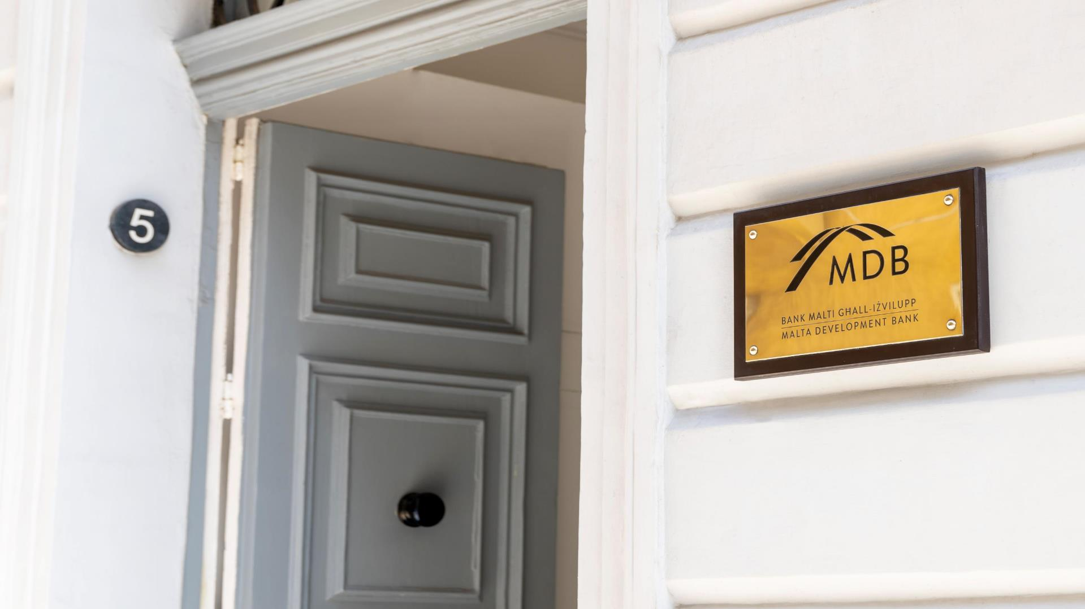
Thank you for your attention
Malta Development Bank,
5 Market Street,
Floriana FRN 1083,
Malta.
W: https://mdb.org.mt
E: info@mdb.org.mt
T: 2226 1725/ 79475901

