Slide 1
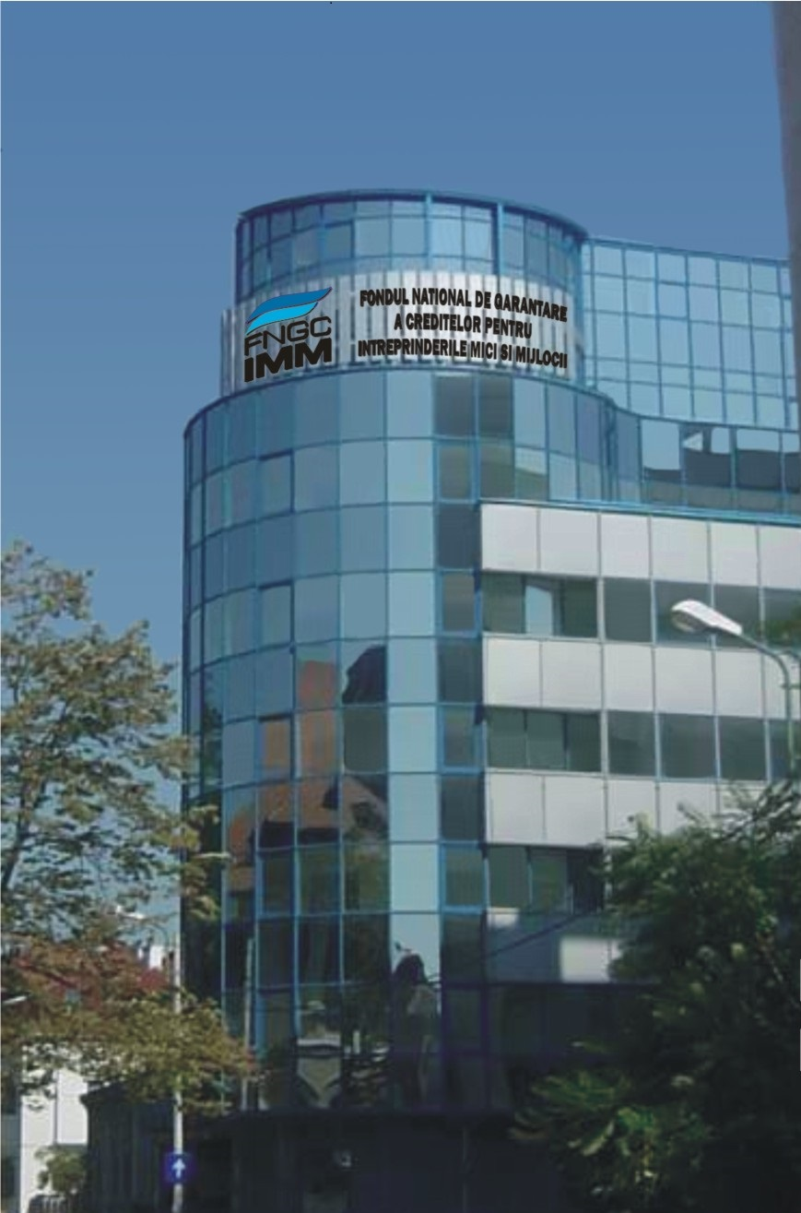
ROHEALTH Clusterul pentru Sănătate și Bioeconomie
BEHEALTH 2025 - Hybrid International Event in Healthcare
FNGCIMM – PERSPECTIVES 2026
FINANCIAL INSTRUMENTS WITH EUROPEAN FUNDS DEDICATED TO THE SME SECTOR IN ROMANIA
22 - 25 October
Cluj-Napoca,
Romania
Presentation by Ciprian ALIC
20 - 24 October 2025
Bucharest, Romania
Hosted by

Slide 2
24 YEARS OF EXPERIENCE
WHO WE ARE
FNGCIMM SA - IFN is a non-banking financial institution, with venture capital, a Romanian legal entity founded in 2001 under private law, organized as a joint stock company, with the sole shareholder being the Romanian state, represented by the Ministry of Finance.
FNGCIMM SA - IFN operates under the supervision of the National Bank of Romania, which permanently monitors the Fund's activity (through monthly reports submitted and the transmission of internal regulations). The Fund is subject to periodic control by the Court of Accounts of Romania and is audited annually by an external auditor.
In the last 4 years, FNGCIMM SA - IFN has managed several state aid schemes (based on the mandate granted by the Ministry of Finance), through which grants were awarded to SMEs covering financing costs - interest on loans guaranteed by FNGCIMM SA - IFN, the guarantee fee and the risk fee (managed by the Ministry of Finance).

Slide 3
24 YEARS OF EXPERIENCE
WHO WE ARE
In addition, in the last 3 years FNGIMM SA - IFN has been managing a combination of a financial instrument (guarantee type) with a grant (10% of the value of the financing granted to the SME). In conclusion, through the activity it manages from its own sources, from sources under administration and on behalf and account of the state, FNGCIMM SA - IFN proves that it has the ability to manage different funds, fulfilling a role similar to that of a Participation Fund, without generating any conflicts of interest, at costs considered attractive by the final beneficiaries and financing partners.
WHAT WILL WE SUPPORT THROUGH FINANCIAL INSTRUMENTS SUPPORTED BY EUROPEAN FUNDS?
Smart development for new businesses
Support for social and insertion enterprises
Support for SMEs in the development regions of Southwest Oltenia and Center

Slide 4
FINANCIAL INSTRUMENTS WITH EUROPEAN FUNDS PROGRAMS 2021-2027
DEFINITIONSDEFINITIONS
FINITIONS
- MIPE : Ministry of Investments and European Projects
- MF : Ministry of Finance
- FNGCIMM : National Credit Guarantee Fund for Small and Medium-sized Enterprises
- POCIDIF : Operational Program for Smart Growth, Digitalization and Financial Instruments
- PEO : Education and Employment Program
- PR SVO: South-West Oltenia Regional Program, run by the South West Oltenia Regional Development Agency
- PR CENTRU Regional Program run by the Centru Regional Development Agency

Slide 5
1. FINANCIAL INSTRUMENT THROUGH OPERATIONAL PROGRAM SMART GROWTH, DIGITALIZATION AND FINANCIAL INSTRUMENTS - PoCIDIF
REGULATORY FRAMEWORK: EUROPEAN REGULATIONS; GOVERNMENT MEMORANDUM; Financing Agreement FNGCIMM – MIPE- no. MIPE G2025-71787/20.06.2025
FULL TITLE: PoCIDIF (Ro) = Operational Program Smart Growth, Digitalization and Financial Instruments
PRIORITY: P1 – Supporting and promoting an attractive and competitive research, development and innovation system in Romania
ACTION: 1.5. - Support for increasing the competitiveness of enterprises
MEASURE: 1.5.2 – Smart development of enterprises: new models for business development and re-technologization
FUNDING SOURCE: European Regional Development Fund
FUNDING AGREEMENT VALUE: 113,410,000 EURO, of which:
Guarantee component 79,387,000 EURO, of which:
Grant component 172,183,598 RON, equivalent to 34,023,000 EURO

Slide 6
1. FINANCIAL INSTRUMENT THROUGH OPERATIONAL PROGRAM SMART GROWTH, DIGITALIZATION AND FINANCIAL INSTRUMENTS-PoCIDIF
FINAL BENEFICIARY TYPE: Microenterprises, small and medium-sized enterprises, small enterprises with mid-market capitalization, start-ups
FINANCIAL INSTRUMENT CHARACTERISTICS IN BRIEF
The eligibility of FNGCIMM for the approval of the direct entrustment of the implementation of the Financial Instrument through Operational Programs in the financial year 2021-2027, was the subject of several meetings attended by representatives of MIPE, MF, FNGCIMM SA - IFN as well as those of the European Commission.
The entire financial allocation from POCIDIF intended for the guarantee-type financial instrument, except for the amount intended to cover the management fee due to the manager of the Specific Fund = FNGCIMM, will be directed to supporting eligible final beneficiaries from all regions of the country through the guarantee-type Financial Instrument combined with a grant in a single operation, with the application of the rules provided for in Regulations (EU) No. 1060 and no. 1058 of 2021. Records will be kept separately for the 2 forms of support.

Slide 7
1. FINANCIAL INSTRUMENT THROUGH OPERATIONAL PROGRAM SMART GROWTH, DIGITALIZATION AND FINANCIAL INSTRUMENTS-PoCIDIF
-
IMPLEMENTATION LOGIC
MIPE, through the POCIDIF Management Authority, based on the Financing Agreement with FNGCIMM which fulfills the role of Manager of the Specific Guarantee Fund, releases tranches from POCIDIF to the Fund. The Fund is obliged to send reports and payment requests to the POCIDIF Managing Authority. FNGCIMM selects the Financial Intermediaries. Based on the Operational Agreement signed with each Financial Intermediary selected through the procedure in a transparent way (banks or other eligible entities), it carries out the Portfolio Guarantee and the grant component.
The Financial Intermediaries are obliged to submit periodic Reports to the Fund and to request the grant for the final beneficiaries and, where applicable, execute the guarantees in case of non-payment.
The Financial Intermediary administers the credit component of the combined instrument but also the grant component intended for the final beneficiaries. The Financial Intermediary draws up a Credit Agreement with the final beneficiary and makes an assessment of the granting of the grant requested by the Final Beneficiary.

Slide 8
2. FINANCIAL INSTRUMENT THROUGH PEO-EDUCATION AND EMPLOYMENT PROGRAM
REGULATORY FRAMEWORK: EUROPEAN REGULATION; GOVERNMENT MEMORANDUM; Financing Agreement FNGCIMM -MIPE no. MIPE 115/25.07.2024
FULL TITLE: PEO = Education and Employment Program / PRIORITY: P4 – Entrepreneurship and social economy
ACTION: E.S.O 4.1. – Improving access to the labor market and activation measures for people looking for a job, especially for young people, including by promoting self-employment and the social economy. MEASURE: 4.a.3 Support for the development of social and insertion enterprises
FUNDING SOURCE: European Social Fund +
Value of the financing agreement = 99,411,764 EURO of which:
➢ guarantee component: 49,705,882 euro
➢ grant component = 49,705,882 euro
Type of final beneficiary : Social enterprises and insertion social enterprises according to the Social Economy Law no. 219/2015, as amended and supplemented

Slide 9
3. FINANCIAL INSTRUMENT THROUGH PRSVO-SOUTH WEST OLTENIA PROGRAM
REGULATORY FRAMEWORK: EUROPEAN REGULATION; GOVERNMENT MEMORANDUM; Financing Agreement ADR SVO -FNGCIMM- No. 24042880/2.11.2024 South West Oltenia Region
FULL NAME: South West Oltenia Regional Program (PR SVO)
PRIORITY: P1-Competitiveness through innovation and dynamic enterprises
ACTION: 1-Improving competitiveness and innovation in microenterprises and SMEs through dedicated operations
MEASURE: RSO 1.3. – Intensifying sustainable growth and increasing the competitiveness of SMEs and creating jobs within SMEs, including through productive investments
FUNDING SOURCE: European Regional Development Fund (ERDF)

Slide 10
3. FINANCIAL INSTRUMENT THROUGH PRSVO-SOUTH WEST OLTENIA PROGRAM
Value of the financing agreement: 29,411,765 EURO of which:
Guarantee component = 17,647,059 EURO of which:
o Grant component: 11,764,706 EURO
Type of final beneficiary
Economic operators operating in eligible fields, established under the Companies Law no. 31/1990, as subsequently amended and supplemented, from the South West Oltenia Development Region, including start-ups

Slide 11
3. FINANCIAL INSTRUMENT THROUGH PR CENTRU – REGIONAL CENTRU PROGRAM
REGULATORY FRAMEWORK: EUROPEAN REGULATION; GOVERNMENT MEMORANDUM; Financing Agreement ADR CENTRU-FNGCIMM No. RC 100/01.09.2025
FULL NAME: Regional CENTRU Program (PR CENTRU)
PRIORITY: P1 – A competitive region through innovation and dynamic enterprises for a smart economy
ACTION: 4-Growth of SMEs through investments, industrial modernization, technological advance and a sustainable regional economy. MEASURE: O.S.3 – Intensifying sustainable growth and increasing the competitiveness of SMEs and creating new jobs in SMEs, including through productive investments
FUNDING SOURCE: European Regional Development Fund (ERDF)
FUNDING AGREEMENT VALUE 29,411,765 EURO, of which:
➢ Guarantee component: 25,000,000 EURO of which: - Grant component: 4,411,765 EURO
Type of final beneficiary: Microenterprises and SMEs from Center development region, start-ups

Slide 12
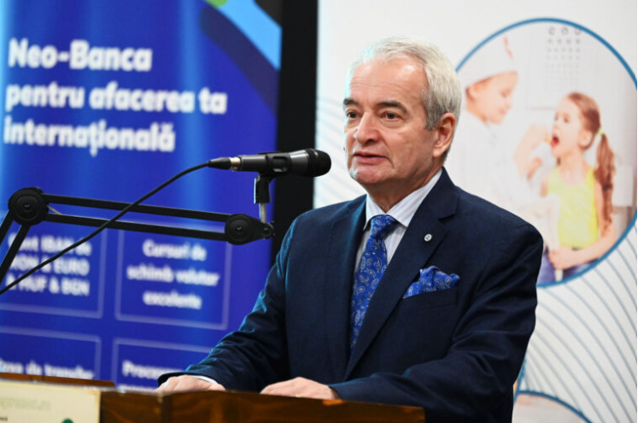

European Association of Guarantee Institutions
Ciprian ALIC
Management Consultant
Member of the Board of Directors
Chairman of WG Digitalization
THANK YOU!
FONDUL NAŢIONAL DE GARANTARE A CREDITELOR
PENTRU NTREPRINDERILE MICI SI MIJLOCII SA-IFN
Str. Stefan Iulian, nr. 38, sector 1, Bucureşti
www.fngcimm.ro E-mail: ciprian.alic@fngcimm.ro

