Slide 1
Improving the regulatory and policy environment for SMEs
AECM Annual Seminar
16 June 2023
Athens
Lucia Cusmano
Deputy Head, Entrepreneurship, SMEs and Tourism Division
Head, SME and Entrepreneurship Transformation Unit
OECD Centre for Entrepreneurship, SMEs, Regions and Cities

Slide 2
Strengthening SMEs and entrepreneurs’ resilience to future crises and shocks
Fostering the contribution of SMEs and entrepreneurs to the green and digital transitions
Enabling SMEs and entrepreneurs to navigate the changing global trade and investment landscape
Enablers
Access to finance
Upskilling and reskilling
Start-up and scale-up
SME lens in broad-based policies
Inclusive entrepreneurship
No-net Zero without SMEs
People-centred approach

Slide 3
Recent crises hit SMEs hard, exposing structural vulnerabilities
Financial fragility
Small cash buffers
Constraints in accessing external finance and over-reliance on traditional bank debt
Gaps in finance management skills and planning
Weak supply chain capabilities
Small inventories and dependence on few supplier and buyer networks
Limited bargaining power to enforce attractive payment conditions
Low preparedness to accelerated changes in Global Value Chains
Lags in adoption of digital technologies
Accelerated digitalisation, but challenges remain

Slide 4
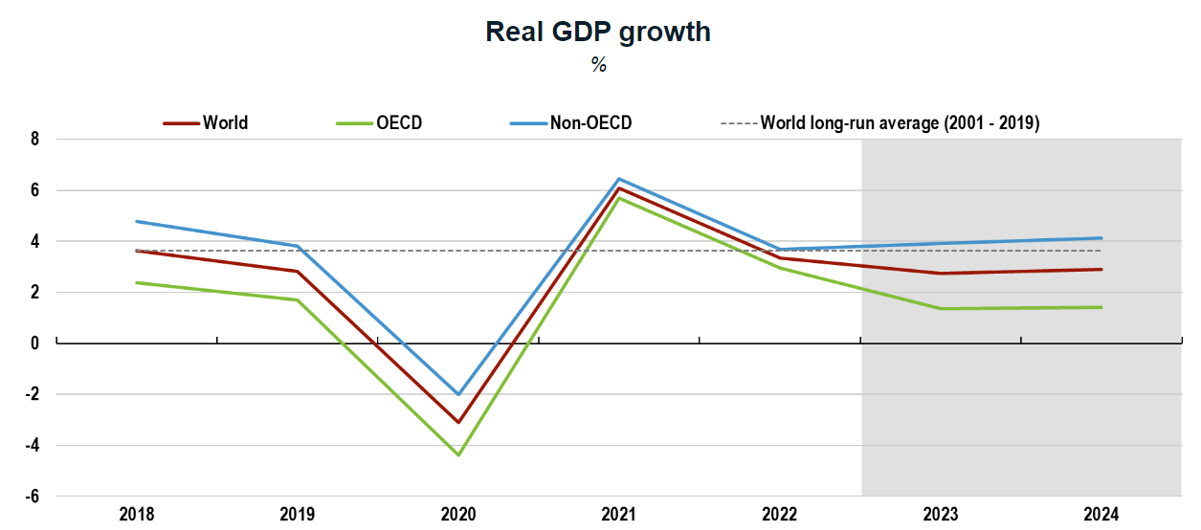
The economic outlook is uncertain: global growth has stabilised but inflation pressures remain high
Global GDP growth is projected to moderate from 3.3% in 2022 to 2.7% in 2023, before edging up to a still subdued 2.9% in 2024.
Consumer confidence improved, and enterprise survey indicators rebounded explained in part by a decline in energy and food prices.
Source: OECD Economic Outlook, June 2023

Slide 5
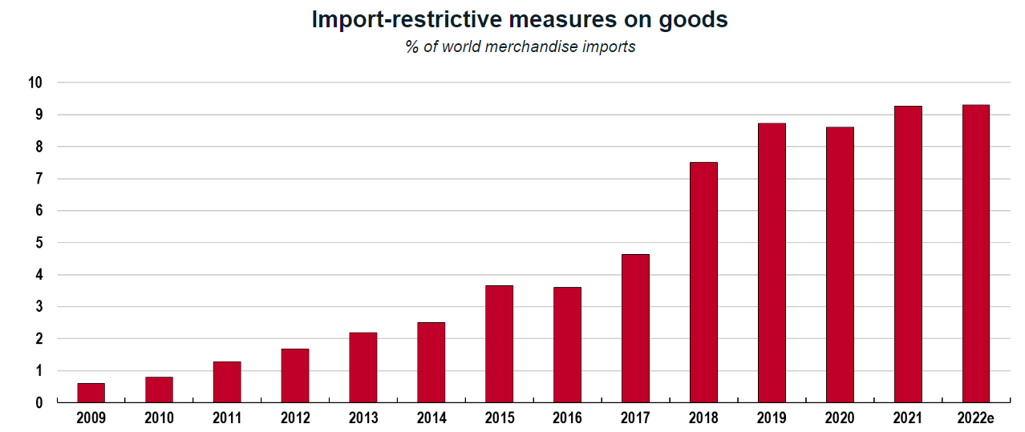
The pandemic and geopolitical tensions created strains in global trade and supply chains
Source: OECD Economic Outlook, June 2023

Slide 6
Credit conditions for SMEs have tightened, leading to stricter lending requirements
Collateral requirements
Percentage of SMEs requiring collateral
A large proportion of SMEs have pointed to higher borrowing costs and collateral requirements, and lower credit availability.
By the end of 2022, a large number of banks reported rising rejection rates for loans.
In the Euro area, Q4 2022 and Q1 2023 registered the largest net tightening in SME credit standards since the sovereign debt crisis in 2011 (Bank Lending Survey, April 2023).
Source: Financing SMEs and Entrepreneurs Scoreboard: 2023 Highlights

Slide 7
SMEs appear to be prioritising the need for savings and putting their investments on hold…
As bank lending becomes less attractive for SMEs, many rely on savings to meet their cash flow needs.
Yet delaying critical investments affects SME competitiveness and slows their transition to sustainability and the digital economy.
Trends of expected investment index
Source: 2023 Eurochambres Economic Survey

Slide 8
… which risks widening gaps and missing opportunities from fast changing markets and technologies
Gaps in digital adoption
OECD average of enterprises using respective digital technologies, 2021 or latest year available
Source: OECD ICT Access and Usage by Business Database

Slide 9
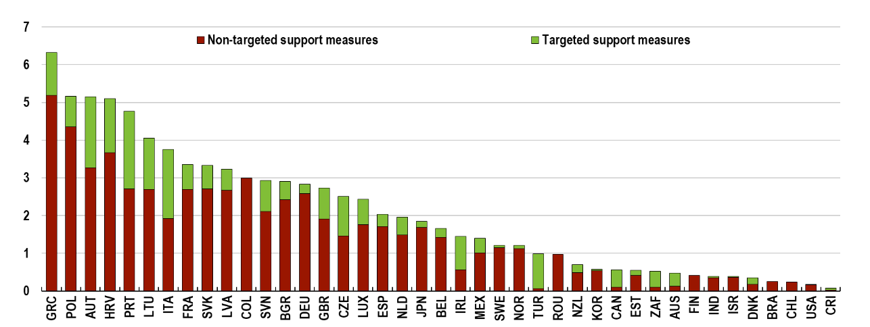
Government crisis responses were massive and wide-ranging, but entail trade-offs between short-term support and long-term objectives
Fiscal Support in response to COVID-19
(% of 2020 GDP)
Fiscal cost of energy support measures, 2022-2023
% of GDP
Source: IMF Fiscal Monitor, April 2021
Source: OECD Economic Outlook, June 2023

Slide 10
It is urgent to keep sight of the long-term objectives and embark SMEs in the green and digital transition
SME share of GHG emissions in the business sector, 2018
Source: OECD Pilot Dashboard on SME greening indiictaors

Slide 11
SMEs should take front stage in policy and regulatory agendas: from “exempting” to “enabling”
Growing and broadening regulatory requirements to disclose environmental and sustainability performance, ‘trickling down’ to exempted SMEs through finance markets and supply chains
Beyond compliance, monitoring and reporting on sustainability can
become a driver of competitiveness (attracting customers, talents, investors)
enable financial institutions to design suitable instruments
Challenge
Most SMEs do not measure their environmental performance (data gap)
SMEs often do not have the capacity to understand requirements and report (awareness and reporting gap)
How to account for the broad diversity of SMEs to better tailor reporting requirements? What matters for their risk profile?
it is critical to better integrate the SME perspective early on in policy and regulation

Slide 12
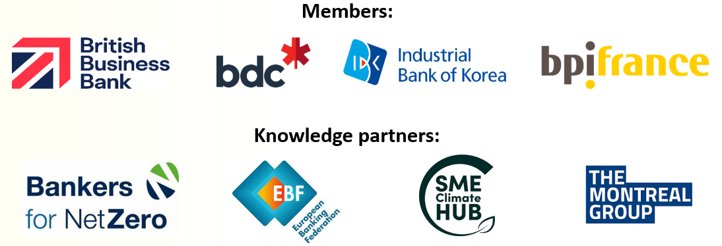
OECD Platform on Financing SMEs for Sustainability
OECD
Public banks
Private banks
SMEs
Governments
Forum for dialogue and knowledge sharing
Quarterly webinars on topics pertaining to SME sustainable finance
Bimonthly BBL meetings
Driving data and analytical work on financing SMEs for sustainability
Analytical reports and short policy notes
Surveys
Networking among ecosystem actors
Regular meetings between members and knowledge partners
Annual conference
Fintechs

Slide 13
Key areas of focus in 2023
Bridging SME data and reporting gaps
Transition finance and strategy: financing high emission sectors to get to net zero
Key topics for policy notes and knowledge-sharing events
Boosting SME demand for sustainable finance

Slide 14
OECD Council Recommendation on SME Financing
Improve the evidence base for SME finance
Improve transparency in SME finance markets
Design sound financial regulations
Promote financial inclusion
Enhance financial skills and strategic vision
Strengthen access to traditional bank financing
Enable alternative sources of finance
Leverage the role of Fintech to reduce barriers for SMEs
Strengthen sustainable finance for SMEs
Strengthen the resilience of SME finance in times of crisis
Encourage timely payments in business transactions
Ensure additionality and cost-effectiveness in SME finance programmes
Promote risk sharing between public and private sector in SME finance programmes
Monitor and evaluate SME finance programmes
Embodies the 2022 Updated G20/OECD High-Level Principles on SME Financing, welcomed by G20 Leaders in November 2022.
Focus on the need to strengthen the conditions for access to both bank and non-bank finance, data collection and policy benchmarking
As an OECD legal instrument, provides greater visibility and mechanisms to support implementation/dissemination
Launch of the Recommendation at the SME & Entrepreneurship Ministerial meeting
Notes:
BACKGROUND INFORMATION
The origins of the G20/OECD High-Level Principles on SME Financing date back to April 2015, when the G20 Finance Ministers and Central Banks’ Governors asked the OECD, together with other relevant international organisations, to develop voluntary high-level principles on SME financing .
These Principles, welcomed by G20 Leaders in November 2015, are voluntary and non-binding, and emphasise the need to strengthen SME access to traditional bank financing, while also promoting non-bank finance.
The Principles are addressed to G20 and OECD members and other interested economies, since they can apply to different economic, social and regulatory environments.
They provide broad guidelines for the development of cross-cutting policy strategies, policy benchmarking and the assessment of initiatives on SME financing at the local, national and international levels.
They are complementary to other ongoing efforts to identify operational solutions to support SME financing, in particular those undertaken through the work of the G20 Global Partnership on Financial Inclusion (GPFI).
The Principles also aim to encourage dialogue, exchange of experiences and coordination, including regulatory coordination, among stakeholders in SME finance, including policy makers, financial institutions, research institutions and SME management.
They are included in the Compendium of Standards of the Financial Stability Board (FSB).

Slide 15
Thank you
lucia.cusmano@oecd.org

